Slide 1
Chapters 2, 4
ER Modeling

Slide 2
Learning Objectives
This class covers:
Basic building blocks of data-modeling
RDBMS (briefly)
Relational data modeling
How business rules influence DB design
Evolution of major data models
if you are not sleeping…
Advanced Data Modeling

Slide 3
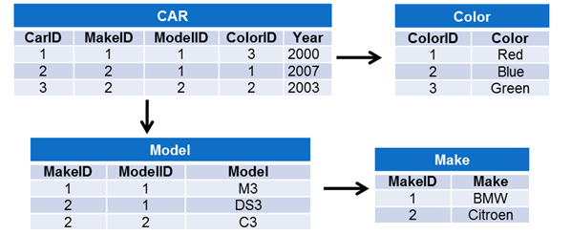
The Relational Database (RDBMS)
Invented by EF Codd circa 1970
Based on a table (a.k.a. relation)
Matrix of intersecting rows and fields
Across are {Tuples, Rows, Records}
Down are {Attribute, Columns, Fields}

Slide 4
RDBMS
Advantages
Disadvantages
Promotes structural independence
Improves conceptual simplicity (ERD/ERM)
Ad hoc query capability in SQL
Isolates end users from physical-level
Improves implementation and management
Requires substantial hardware and system software overhead
Conceptual simplicity gives untrained people the tools to use a good system poorly
May promote information problems
Doesn’t scale well for large datasets

Slide 5
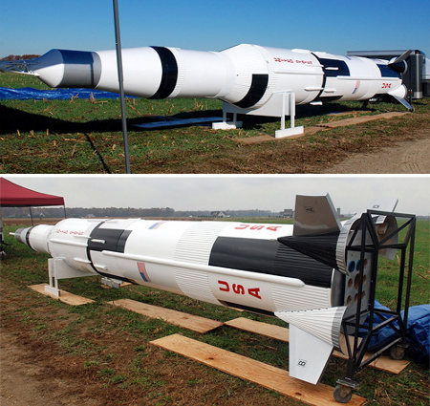
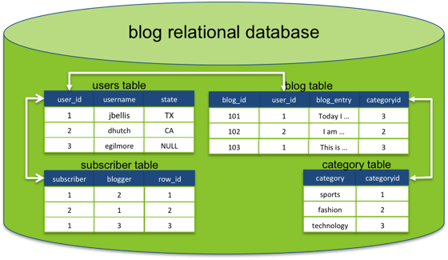


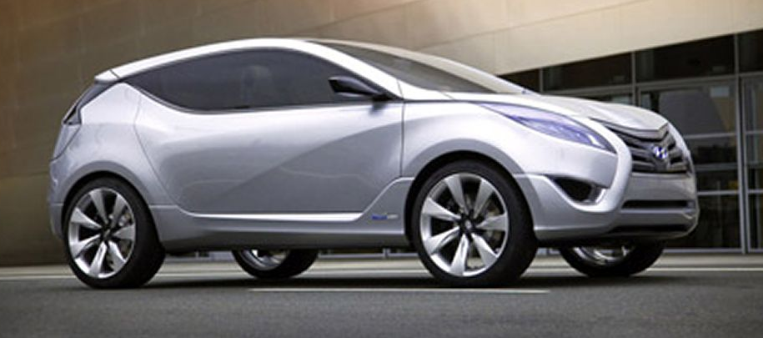
Modeling
Where do we see models?
Cars
Homes
Rockets
People
Data

Slide 6
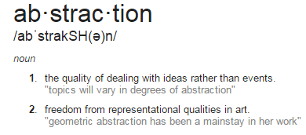

Data Modeling and Data Models
Model - Abstraction of a real-world object or event
Data models: Simplified representations of complex data structures
Data modeling: Iterative process of creating a specific data model for a problem domain
Communication (i.e. end-users and/or customers)
Data/database view at 50,000 feet
Begins to organize data for various data users

Slide 7
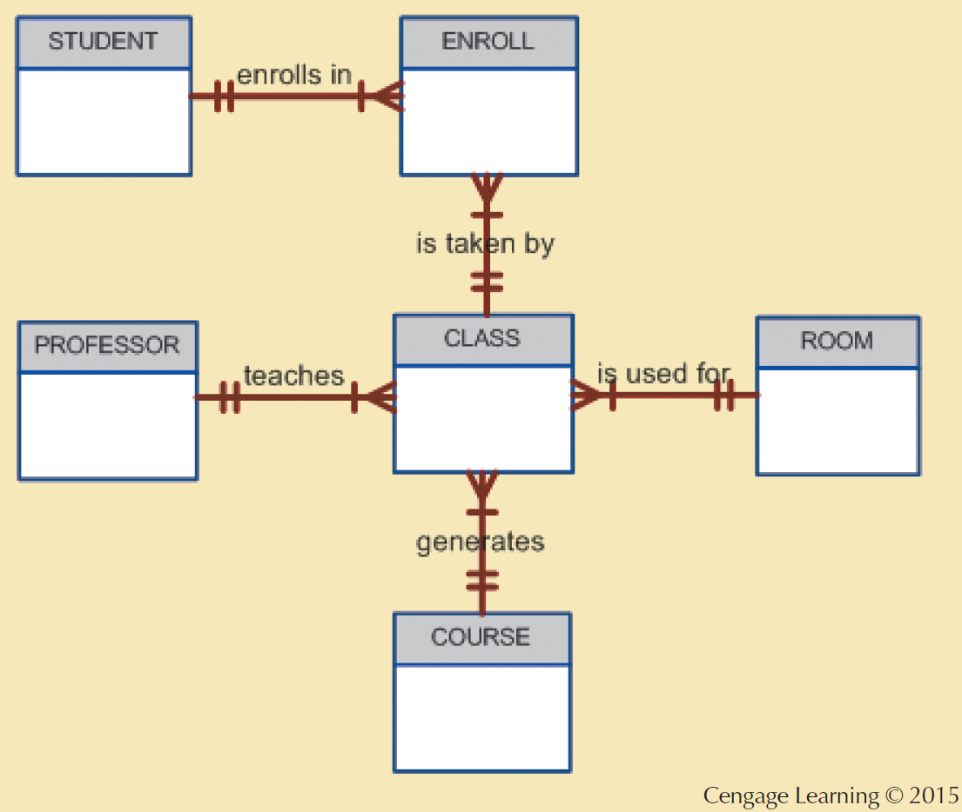
The Entity Relationship Model
Introduced by Peter Chen in 1976
Represents the conceptual model
Graphically represents entities and relationships
Entity relationship diagram (ERD)
Graphical representations model database components
Entity instance or entity occurrence
Rows in the relational table
Connectivity
Describes relationship types

Slide 8
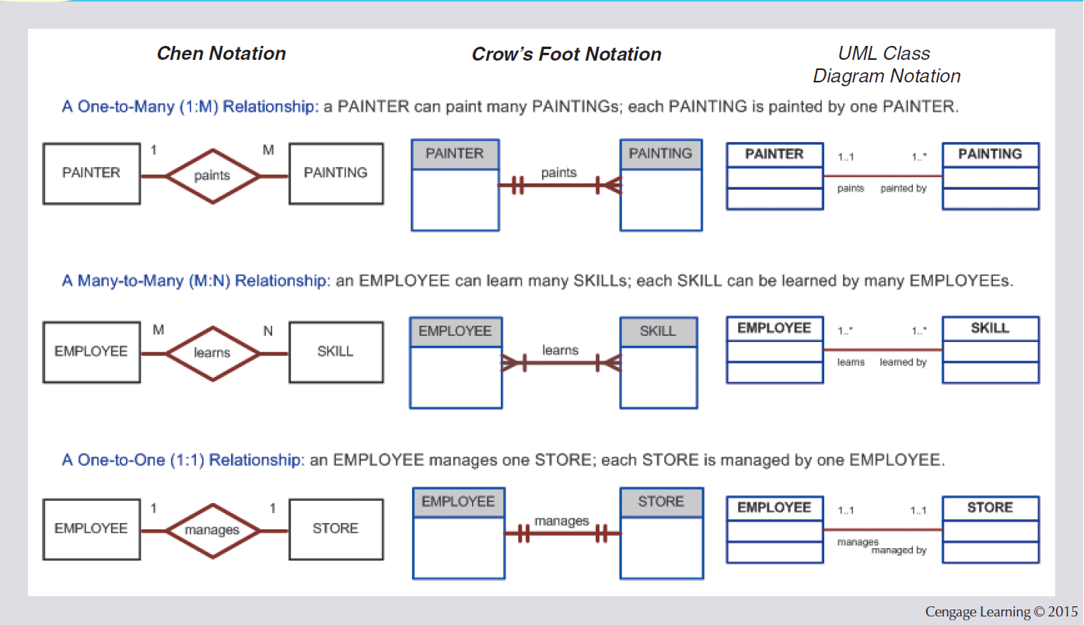
Entity Relationship Model
Advantages
Disadvantages
Visual modeling yields conceptual simplicity
Visual representation makes it an effective communication tool
Is integrated with the dominant relational model
Limited constraint representation
Limited relationship representation
No data manipulation language
Loss of information content occurs when attributes are removed from entities to avoid crowded displays

Slide 9
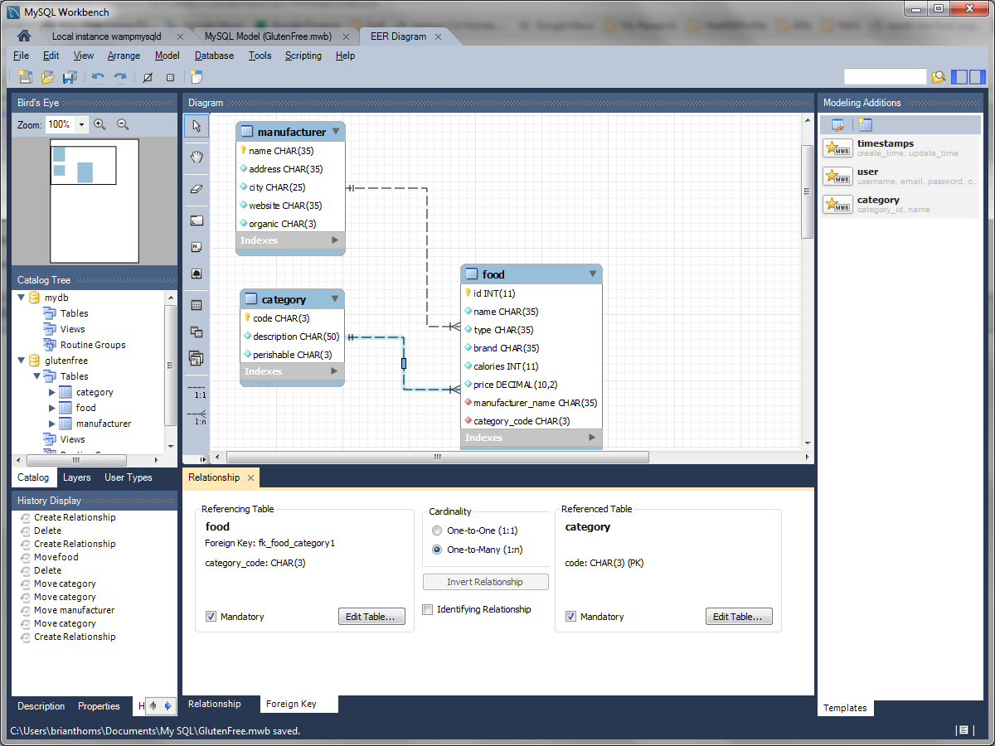
MySQL Workbench Relationships

Slide 10
ER Building Blocks
Entities: Distinct objects used to collect and store data. Comprised of:
Attributes: Characteristics about an entity
Relationships: related attributes that link two entities.

Slide 11
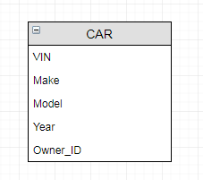

Simple Entity 1 (CAR)
Car Entity
Car Attributes (characteristics)
-
-
-
-

Slide 12
Car Entity as a table
VIN | MAKE | MODEL | YEAR | OWNER_ID
1GYFK36299R035007 | BMW | M3 | 2015 | 5TDFHVPCG
WAUCFAFR9EA386228 | BMW | M5 | 2015 | 6HRGFITSJ
YV1960AS2A1981766 | Subaru | Outback | 2015 | 5MZINQEAT
Metadata is the DBA’s responsibility
Name: MAKE
Data Type: varchar
Size: 12
Description: Make will store car’s make

Slide 13
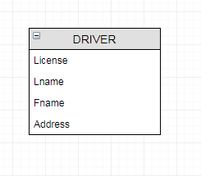
Simple Entity 2 (DRIVER)
Driver Entity
Driver Attributes
-
-
-
-

Slide 14
Driver Entity as a table
LICENSE | LNAME | FNAME | ADDRESS
5TDFHVPCG | Jason | Statham | England
6HRGFITSJ | Brian | Thoms | Los Angeles
5MZINQEAT | Sam | Elliot | Texas
Metadata is the DBA’s responsibility
Name: LNAME
Data Type: varchar
Size: 24
Description: Captures driver’s last name

Slide 15
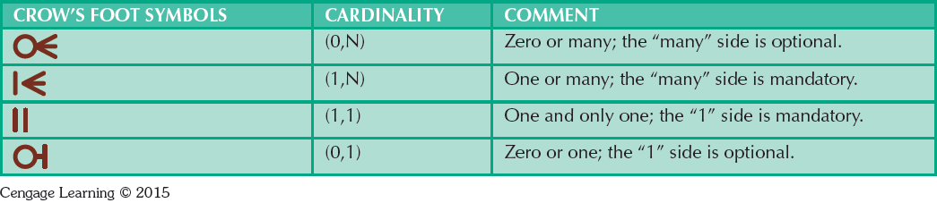
How Entities Relate
Relationship: Describes an association among entities
One-to-many (1:M)
Many-to-many (M:N or M:M)
One-to-one (1:1)

Slide 16

Relationship of Driver to Car?
LICENSE | LNAME | FNAME | ADDRESS
5TDFHVPCG | Jason | Statham | England
6HRGFITSJ | Brian | Thoms | Los Angeles
5MZINQEAT | Sam | Elliot | Texas
How many cars can 1 driver legally own?
0 to many since 1 driver can own zero or many cars
VIN | MAKE | MODEL | YEAR | OWNER_ID
1GYFK36299R035007 | BMW | M3 | 2015 | 5TDFHVPCG
WAUCFAFR9EA386228 | BMW | M5 | 2015 | 6HRGFITSJ
YV1960AS2A1981766 | Subaru | Outback | 2015 | 5MZINQEAT

Slide 17
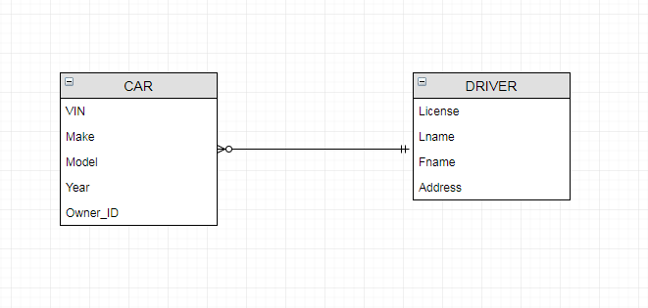
Relationships
Which table, captures information from the other? And why?

Slide 18
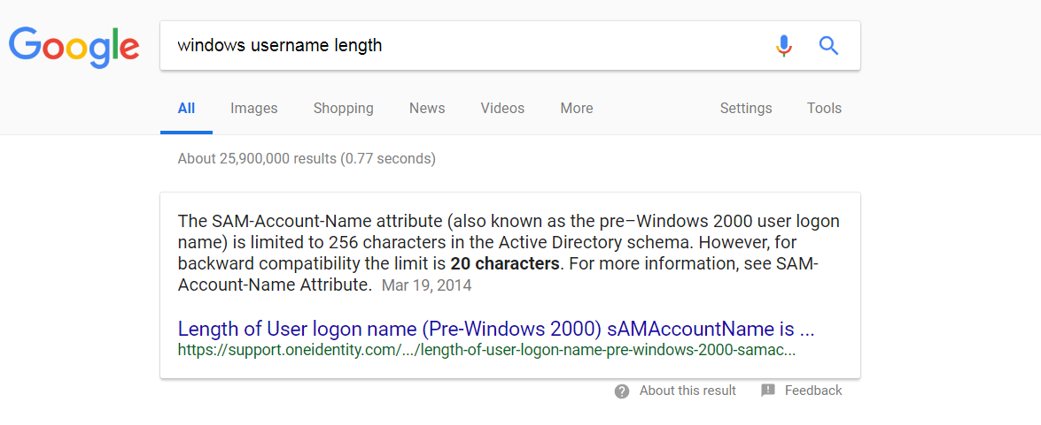
Constraints
Constraint: Set of rules that ensure data integrity (driven by business rules)
VIN > 0 and 17 digits long
Model Year < Current_Year + 1, Odometer > 0
Constraints are often defined by a set of Business Rules

Slide 19
Business Rules
Brief, precise, and unambiguous description of a policy, procedure, or principle
Help define the basic building blocks for data
Describe the main and distinguishing characteristics of the data

Slide 20
Sources of Business Rules
Company managers
Policy makers
Department managers
Written documentation
Direct interviews with end users
Industry Standards
Speed 65
If I am storing an MD5 hashed password, what should the size of my field be?
MD5, WEP
Examples?

Slide 21
Reasons for Identifying and Documenting Business Rules
Standardize company view of data
Communications tool between users and designers
Allow designers to:
Understand role, scope of data, and business processes
Develop participation rules and constraints
Create accurate data models

Slide 22
Translating Business Rules into ER Model Components
Nouns translate into entities
Car, driver, student, class, etc
Verbs translate into relationships among entities
Drivers drive cars
Cars must have unique VIN
Students take/register classes, Faculty teach classes
Relationships are bi-directional.
Questions to identify the relationship type
How many instances of B are related to one instance of A?
How many instances of A are related to one instance of B?

Slide 23

Attributes (1)
Characteristics of entities, which translate to fields during DB implementation
Required attribute: Must have a value, cannot be left empty (i.e. cannot be NULL)
DolphinId for a STUDENT entity
Firstname?
Optional attribute: Does not require a value, can be left empty (i.e. can be NULL)
Middle_Initial, Demographic, AddressLine2
DolphinId for a CLUB entity
Domain - Set of possible values for a given attribute
Balance {All positive Integers}, Zip{Zip lookup table}
Identifiers: One or more attributes that uniquely identify each entity instance
Required attribute (see above)
Q. What datatype for Zip Code?

Slide 24
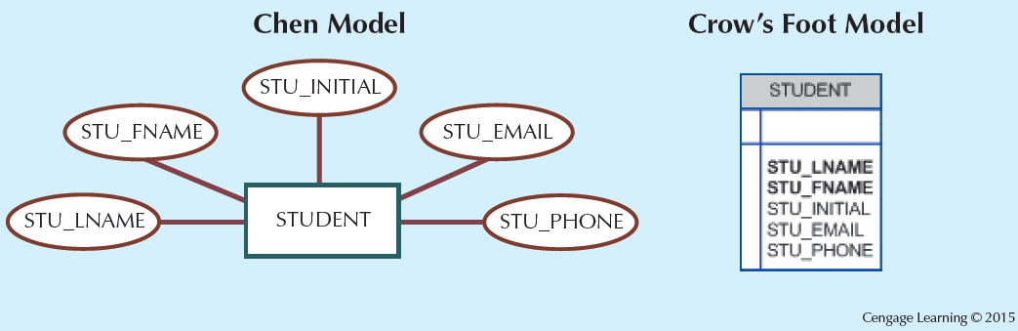
Attributes (2)
STU_ID
Notice the naming conventions!

Slide 25
Attributes (3)
Composite identifier (composite key): Primary key composed of more than one attribute
Composite attribute: Attribute that can be subdivided to yield additional attributes
Name, Address, Phone, DOB
Simple attribute: Attribute that cannot be subdivided
Age
Single-valued attribute: Attribute that has only a single value
JobTitle {professor}
Derived attribute: Attribute whose value is calculated from other attributes
Multivalued attributes: Attributes that have many values
Hobbies {biking, hiking, clubbing}
Learn to avoid multivalued attibutes

Slide 26
Multivalued Attributes
Table name: STUDENT
stu_id | first_name | last_name | hobbies
1639 | George | Barnes | reading
5629 | Susan | Noble | hiking, movies
3388 | Erwin | Star | hockey, skiing
5772 | Alice | Buck | NULL
1911 | Frank | Borders | photography, travel, art
4848 | Hanna | Diedrich | gourmet cooking
How to query students who like traveling?

Slide 27
Multivalued Attributes (Cont’d)
How are these tables linked?
What is the connectivity of this relationship?
Table name: HOBBY
stu_id | hobby
1639 | reading
5629 | hiking
5629 | movies
3388 | hockey
3388 | skiing
1911 | photography
1911 | travel
1911 | art
4848 | gourmet cooking
Table name: STUDENT
stu_id | first_name | last_name
1639 | George | Barnes
5629 | Susan | Noble
3388 | Erwin | Star
5772 | Alice | Buck
1911 | Frank | Borders
4848 | Hanna | Diedrich

Slide 28
Relationships
Association between entities always operate in both directions
Participants: Entities that participate in a relationship
Connectivity: Describes the relationship classification
Cardinality: Expresses the minimum and maximum number of entity occurrences associated with one occurrence of related entity

Slide 29
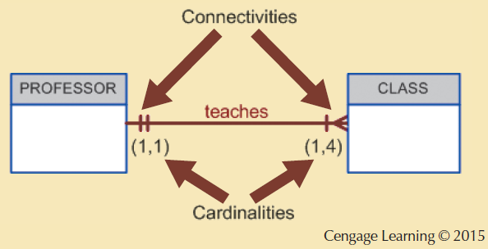
Connectivity and Cardinality
Identify 1 or 2 business rules.

Slide 30
Cardinality
?
Table name: HOBBY
contactid | hobby
1639 | reading
5629 | hiking
5629 | movies
3388 | hockey
3388 | skiing
1911 | photography
1911 | travel
1911 | art
4848 | gourmet cooking
Table name: CONTACTS
contactid | firstname | lastname
1639 | George | Barnes
5629 | Susan | Noble
3388 | Erwin | Star
5772 | Alice | Buck
1911 | Frank | Borders
4848 | Hanna | Diedrich

Slide 31
Entity Dependence
Existence dependence
Existence independence
Entity exists in the database only when it is associated with another related entity occurrence
Referred to as a weak entity
Has a strong (identifying) relationship with another entity.
Entity exists apart from all of its related entities
Referred to as a strong entity or regular entity
Has a weak (non-identifying) relationship with another entity.

Slide 32
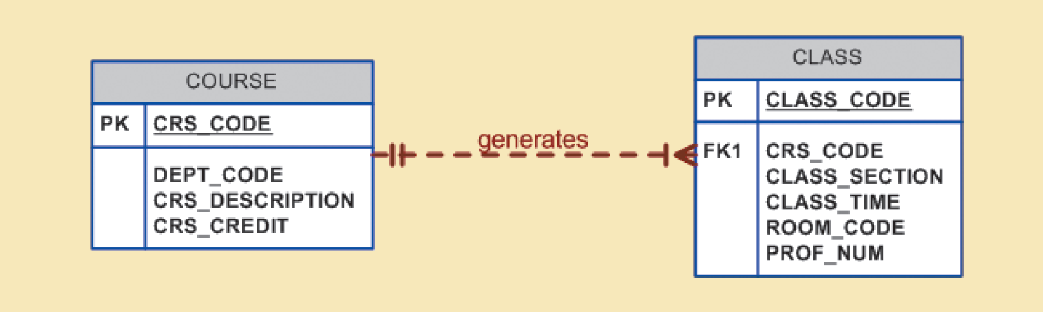
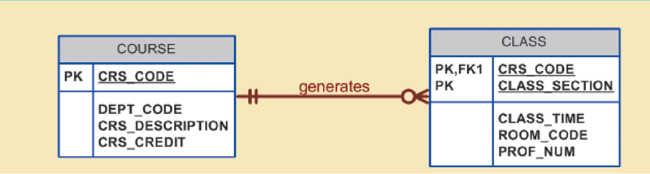
Strong Entity vs. Weak Entity
Cengage Learning © 2015

Slide 33
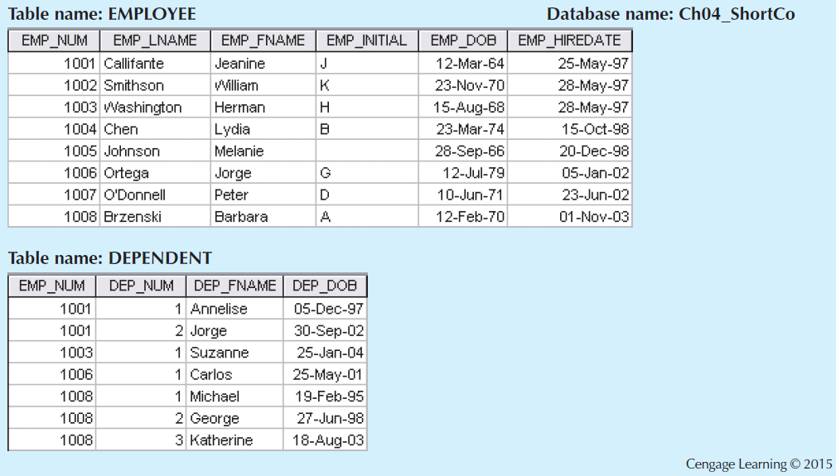
A Weak Entity in a Strong Relationship

Slide 34
Relationship Participation
Optional participation
One entity occurrence does not require a corresponding entity occurrence in a particular relationship
Mandatory participation
One entity occurrence requires a corresponding entity occurrence in a particular relationship

Slide 35
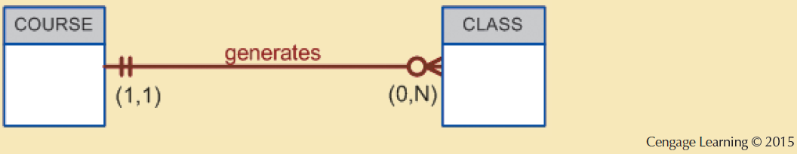
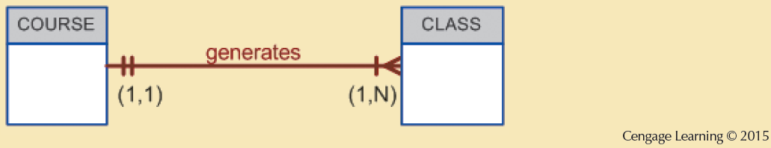
Optional vs. Mandatory
These are very different relationships

Slide 36
M:N Relationships
Many-to-Many relationships are to be avoided at all costs.
Many students can enroll in many courses. Of course. But …
Many employees work on many projects. Of course. But …

Slide 37
Associative Entities
Also known as composite or bridge entities (Thoms calls them intersection tables)
Used to represent an M:N relationship between two or more entities
Is in a 1:M relationship with the parent entities
Composed of the primary key attributes of each parent entity
May also contain additional attributes that play no role in connective process

Slide 38
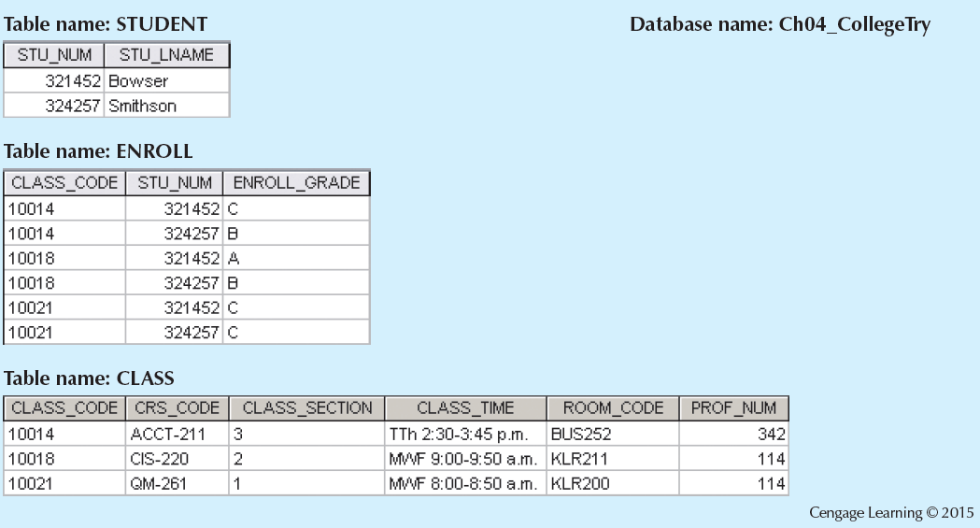
Converting the M:N Relationship into Two 1:M Relationships

Slide 39
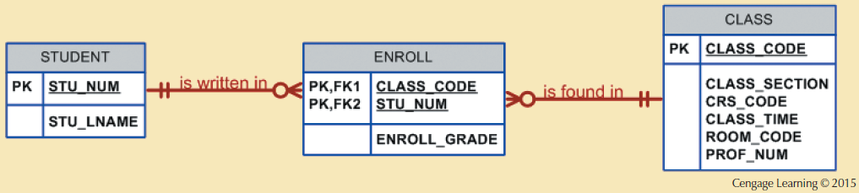
A Composite Entity in an ERD
Enrollment is a composition of a single student and a single class section.

Slide 40
A Note on Naming Conventions
Entity names:
Descriptive
Terminology familiar to the users
Attribute names:
Descriptive of the data represented by the attribute
Proper naming conventions:
Facilitates communication between parties
Promotes self-documentation

Slide 41
Two implementations of the same data
Sales View
Accounting View
Entity: CAR
Attribute: OID
Description: Owner ID
Datatype: Integer
Field Size: 12
Entity: CAR_tbl
Attribute: OWNER_ID
Description: Owner ID
Datatype: VarChar
Field Size: 36
In large organizations with enterprise data, this problem is common.
It’s also a large problem for NoSQL databases.

Slide 42
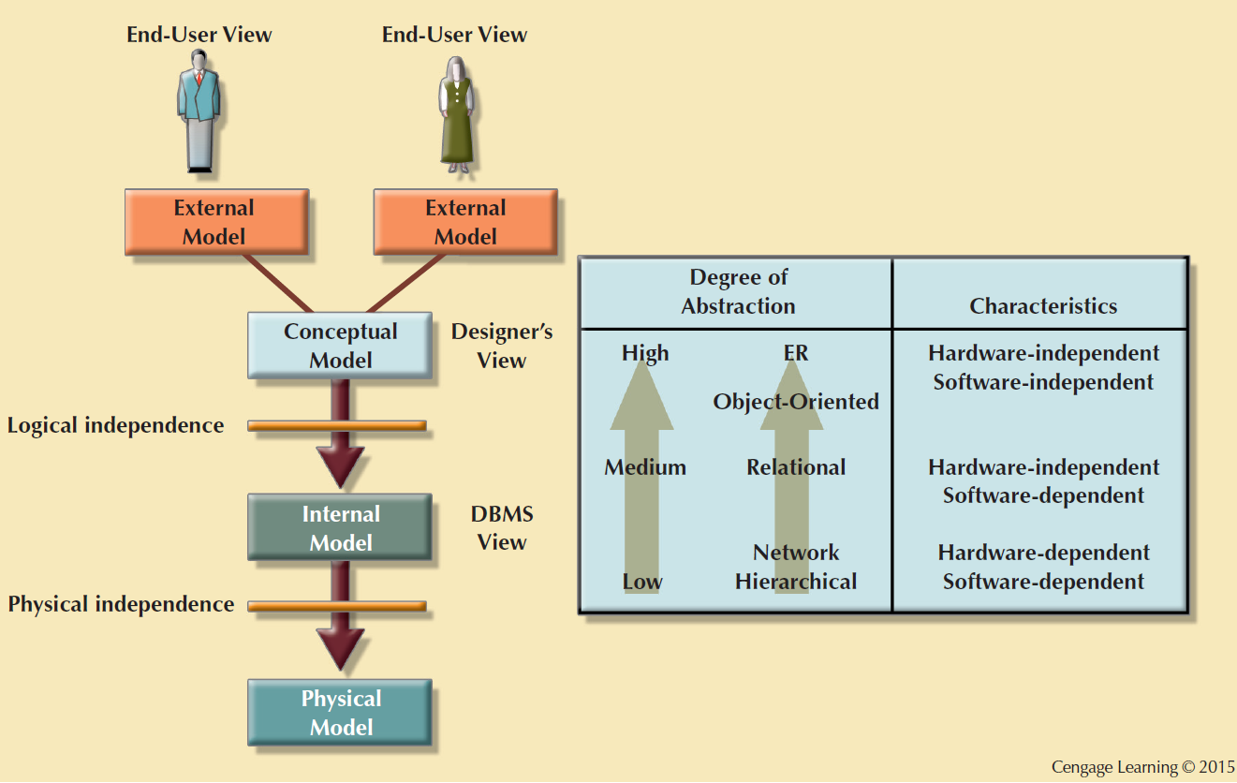
Data Abstraction Levels
Conceptual or Logical Model
An abstraction of the physical database.
Macro-level view of data environment
Basis for the identification and high-level description of the main data objects
Software and hardware independent
Next week, or the following, we will get one level closer to the physical layer.

Slide 43
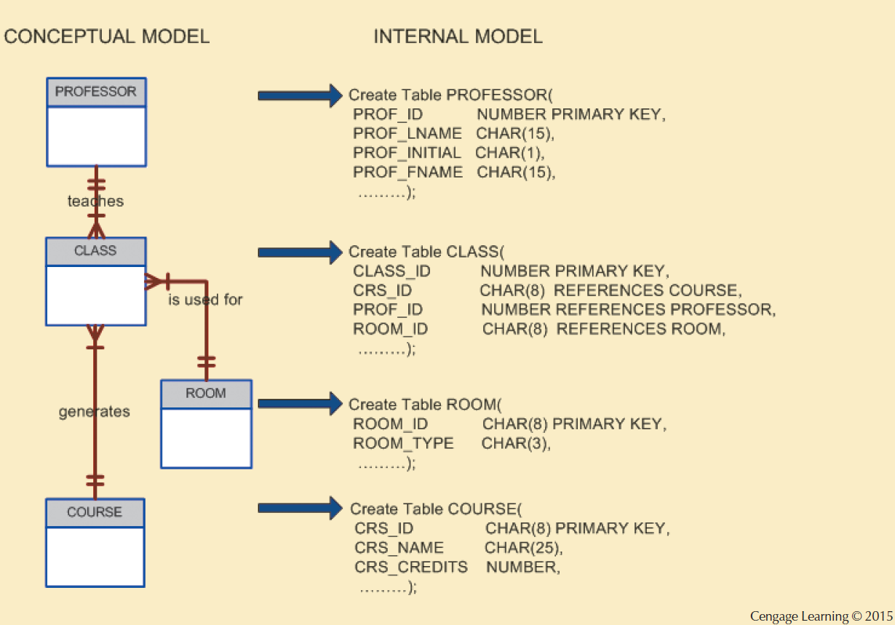
The Internal Model (SQL)
Representing database as seen by the DBMS mapping conceptual model to the DBMS
Internal schema: Specific representation of an internal model
Uses the database constructs supported by the chosen database
Is software dependent and hardware independent
Logical independence: Changing internal model without affecting the conceptual model

Slide 44
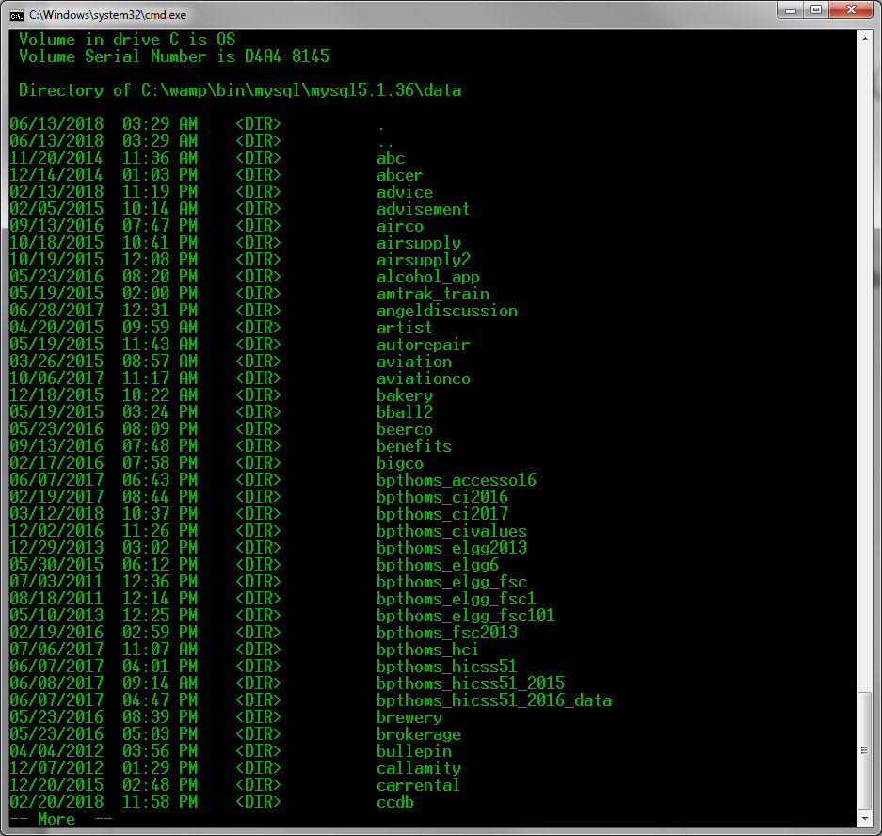
The Physical Model
Lowest level of abstraction
Describes how data persists on storage media
Requires the definition of physical storage and data access methods
Relational model does not require physical-level details
Physical independence: Changes in physical model do not affect internal model

Slide 45
Summary:
Developing an ER Diagram
Create a detailed narrative of the organization’s description of operations
Identify business rules based on the descriptions
Identify main entities and connections (i.e. relationships) from the business rules
Develop the initial ERD
Identify the attributes and primary keys that adequately describe entities
Revise and review ERD

Slide 46
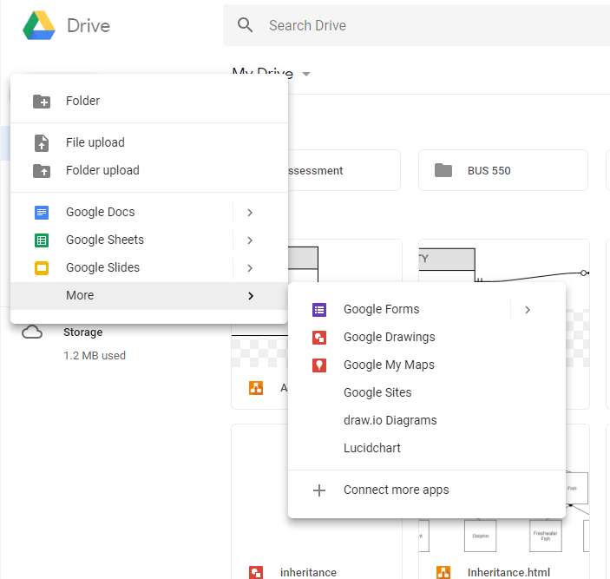
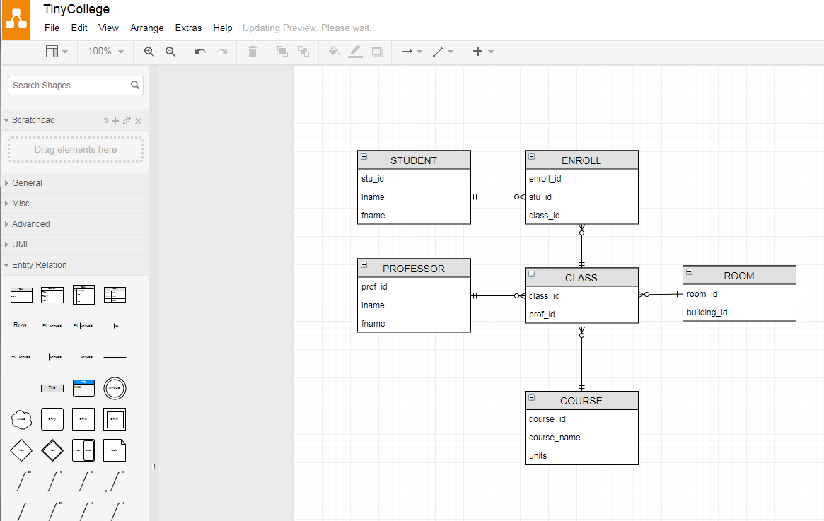
Draw.io (in Google Docs)

